Slide 1
Module 6 : Network Industry Trends and Automation
Internet Communication Engineering

Slide 2
Introduction to SDN
Software defined network (SDN) is an architecture designed to make a network more flexible and easier to manage.
In this, a centralized controller controls the forwarding behavior of a set of distributed switches.

Slide 3
SDN Characteristics
Plane separation, Simplified device, Centralized control, Network automation, Openness
In the SDN architecture, the control and data planes are decoupled.
Network intelligence and state are logically centralized.
And the underlying network infrastructure is abstracted from the application.
SDN focuses on separation of the control plane from the data plane, centralized controller and view of the network.
Also it focuses on open interfaces between the devices in the control plane (controllers) and those in the data plane and programmability of the network by external applications.
Agility. As business and application needs change, administrators can adjust network configuration as required.

Slide 4
Openflow
Openflow is a communication protocol that gives access to the forwarding plane of a network switch or router over the network.
This protocol defines the communication between the SDN controller and the network device/agent.
Openflow is a multivendor standard defined by the Open Networking Foundation (ONF) for implementing SDN in networking equipment.
OpenFlow is only a protocol that allows for the de-coupling of a network device’s control plane from the data plane.
In simplest terms, the control plane can be thought of as the brains of a network device and the data plane can be thought of as the hardware or application-specific integrated circuits (ASICs) that actually perform packet forwarding.

Slide 5
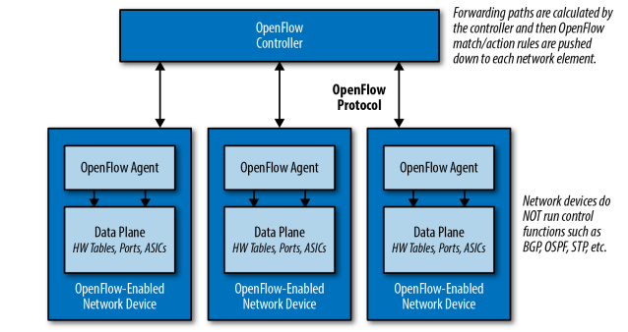
Decoupling with Openflow

Slide 6
Need of SDN
SDN is required because it offers following advantages :
Facilitate innovation in the network.
Layered architecture with standard open interfaces.
Research and experiment using non bulky, non expensive equipment.
Provides more flexibility with programmability.
Easy and simple customization and integration with other software applications.

Slide 7
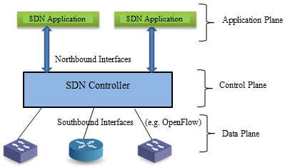
SDN Architecture

Slide 8
Contd…
Network control plane is physically separated from forwarding plane.
It is developing network architecture which is manageable, dynamic, adoptable, cost effective and also it is suitable in applications having high bandwidth.
In SDN controller, network intelligence is logically centralized which keep worldwide view of the network.
This results in the network appears to the applications and policy engines as a single logical switch.
SDN simplifies the network devices as it does not need to understand the process and thousands of protocol standards.

Slide 9
Contd…
SDN is directly programmable as the network control is separated from the forwarding plane.
The network abstraction is simplified by the network administrators and network operators can programmatically configure this network.
SDN allows networks to configure, secure and manage network resources through dynamic and automated SDN programs due to centralizing state in control layer.
It supports a set of APIs.

Slide 10
Contd…
To meet business objective, APIs make it possible to implement common network services such as access control, multicast, routing, quality of service, security, processor and storage optimization, all types of policy management and energy usage.
In short, SDN architecture makes it simple to define and apply consistent policies for both wireless and wired connection.
SDN can change the behavior of the network in real time by centrally managing a network and can install new services and application quickly.

Slide 11
Contd…
Application Layer :
Application layer consists of applications that interact with the SDN controllers and programs through API.
The application layer can include IDS, load balancing or firewalls.
SDN application uses a SDN controller to manage the behavior of data plane.
Control Layer (Control Plane) :
- The control layer consists of centralized SDN controller software that acts as the brain of SDN.

Slide 12
Contd…
The main function of SDN controller is to manage policies and flow of traffic throughout the network.
It receives instructions from SDN application layer and passes them to the networking components.
It also extracts information about the network from hardware devices and then it communicates back to the SDN applications.

Slide 13
Contd…
SDN controller communicates and controls these upper and lower layer with APIs through interfaces.
Infrastructure Layer (Data plane) :
Data plane consists of various physical & virtual network devices.
Main function is data forwarding.
This layer is made up of physical switches. These switches forward the network traffic to their destinations.

Slide 14
Contd…
Application Programming Interfaces (APIs) :
The communication between three layers take place by using respective northbound and southbound APIs.
A northbound interface is a connection between the controller and applications.
A southbound interface is a connection between the controller and the switch.

Slide 15
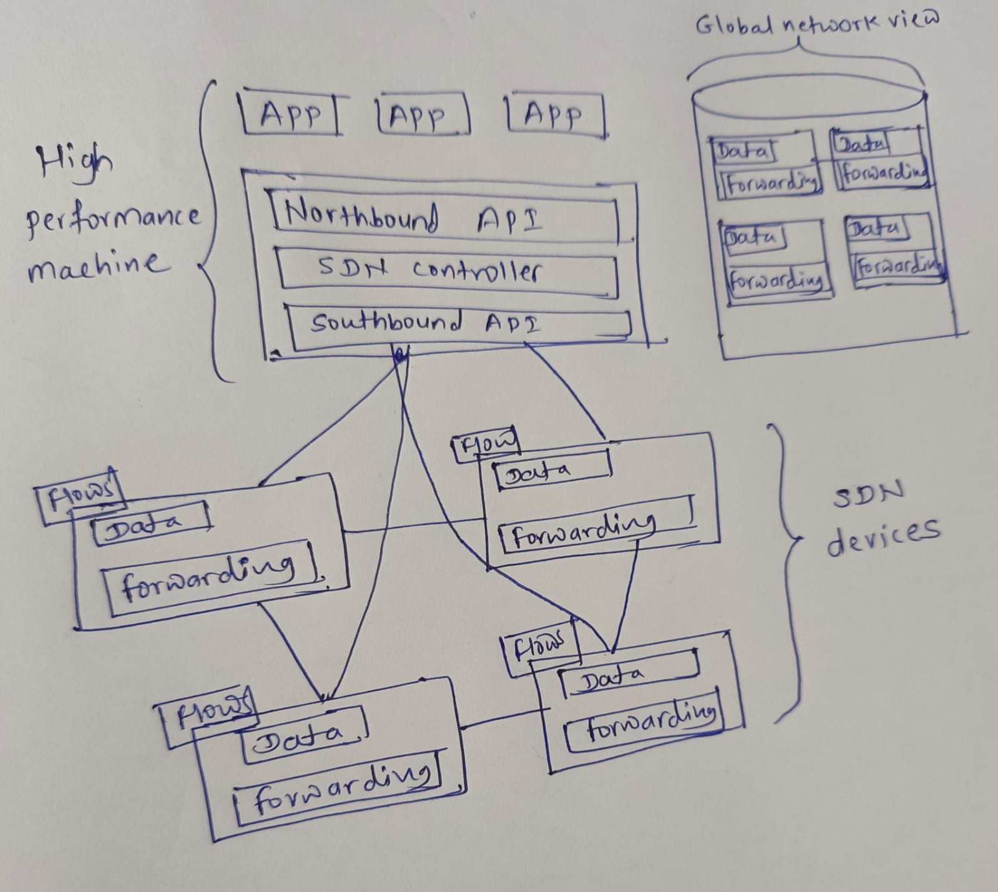
SDN Operation

Slide 16
Contd…
SDN has function data forwarding which decides what to do with each incoming packet and the data drives those forwarding decisions.
The data itself is represented by flows and defined by the controller which is shown in the upper left portion of each device.
A flow explains a set of packets transmitted from one network endpoint to the other.
A flow table located on the network device includes a series of flow entries and actions required to perform the packet matching.

Slide 17
Contd…
When SDN receives a packet, it checks its flow tables in search of a match.
If match is found by SDN device, it takes the proper configured action which involves packet forwarding.
If no match found, switch can either pass the packet to the controller or drop packet depending on the version of openflow and switch configuration.
The SDN controller allows the application to define flows on devices and helps the application in order respond to the packets that are forwarded to the controller by the SDN devices.

Slide 18
Contd…
The global network view is shown on the right corner .It is controlled by the SDN controller.
This allows it to calculate the best forwarding solutions for the network in a conventional and deterministic manner.
These calculations are performed on a high performance machine because one controller can control a large number of network devices.
SDN applications are build up on the top of SDN controller.

Slide 19
SDN Devices
The components of SDN devices are :
API (Application Programming Interface)
Abstraction Layer
Packet processing function

Slide 20
Abstraction Layer
The abstraction layer consists of one or more flow tables.
Flow tables are fundamental data structure.
The flow tables will allow the device to access incoming packets and based on the content of received packet flow table will take appropriate action.
Flow entries consists of match field and actions components.
Actions are instructions which the network device must perform if an incoming packet matches the match field which is specified for that flow entry.
For matching packets and taking appropriate action, the flow table and flow entry structure allow the SDN application developer to have wide range of possibilities.

Slide 21
Packet processing logic
The packet processing logic contains the mechanisms for taking actions based on results of evaluation of incoming packets.
In case of hardware switch these methods are implemented by using specialized hardware.
Same functions are mirrored by software in case of software switch.

Slide 22
SDN Applications
SDN applications runs above the SDN controller.
The responsibility of SDN application is interfacing of the network through the controller’s northbound API.
SDN application manages the flow entries programmed on the network devices using controllers APIs.
SDN applications through the northbound API are able to :
Configure the flows
2. Balance traffic loads
3. React to network topology change
4. Handle security related tasks

Slide 23
Network Automation
Why Network Automation??
Increase in the network size, controlling functionalities become complex.
For very large networks comprising thousands of routers, the complexity involved is very high.
Each router updates its routing table by exchanging their routing information with the neighbouring routers.
Routers in large networks may not be of same make.
The softwares for these devices are defined by the vendors.
So, the network administrator needs to learn the technologies developed by different vendors and configure each device in a traditional network.
Thus, there is requirement of network automation or SDN.

Slide 24
Benefits of Network Automation
Faster : Device configuration is easy and speeds up the implementation of new services and applications.
Reduced probability of errors : Since human interventions are removed, the probability of errors due to negligence are reduced.
Analyse and resolve issues faster : It uses network analytics that helps resolve issues faster than done manually.

Slide 25
Types of Network Automation
The network automation can be applied to various tasks related to networking such as :
Provisioning of devices
Network data collection
Device configuration
Network management
Provide insights to reports
Implementing compliance
Troubleshooting of network issues

Slide 26
Device Provisioning
To bring the device to a state in which it can be allocated to the user.
While installing a new device in a network, it is required to be processed before it is handed it to the end user.
This involves resource creation which enables the device to communicate securely.
It is required to define all the necessary local and global parameters in each device using Command Line Interface (CLI).
Automatic device provisioning can solve this task easily without human interventions.

Slide 27
Data Collection
Network data collection is an important aspect.
SDN can provide intelligent and adptive network data collection with centralized control.

Slide 28
Configuration Management
It includes initial configuration of network devices.
It aims to reduce the complexity in configuration changes and provide ease to fix the configuration errors.
It ensures that the change in the network are incorporated without much disruption.

Slide 29
Migration
Migration from one platform to another is always a tedious task.
Vendors may provide a script or tool to help with migration to their platform but the engineers needs to be trained by the vendor.
Various forms of automation can be used to develop configuration templates for all types of network devices and operating systems such that it is possible to generate a configuration file for all vendors given a defined set of inputs.
This will ease the configuration of devices that are added in the network regardless of the vendor.

Slide 30
Basic Concept of IoT
IoT comprises the things that have unique identities and are connected to the Internet.
The focus of IoT is to configure , control the network via the Internet, the devices or “things” that are traditionally not associated with the Internet.
IoT is a new revolution in the capabilities in sensor networks, mobile devices, wireless communications, networking and cloud technologies.

Slide 31
What is IoT
Internet of Things (IoT) is a network of connected devices such as sensors, electronic equipment, cameras, and many more.
They are programmed in such a way that IoT provides automation for the devices that are connected.
Some of the common IoT devices are smart TVs, refrigerators, and air conditioners.
We just need to give commands to these devices using our smartphone application for operating them.
Also, we use many wearable IoT devices such as smartwatches and wrist bands that show our heartbeat, blood pressure, and the distance we walked.
This is all possible by smartly integrating technologies and equipment together to form an IoT product.
Further, due to the advancements in the field of AI and Machine Learning, the future scope of IoT has impressively increased.
The potential of IoT is not limited to healthcare. There are various other applications of IoT like in Agriculture, automotive and industry.

Slide 32
Need of IoT
Have you ever been in a situation where you went to the market and forgot to switch off your AC, fan, or light and felt helpless that you cannot return home to switch it off? This is where IoT comes into the picture.
It can remind you of the essential tasks that you often forget to do.
Also, using the mobile application, you can access your home appliances integrated with IoT from anywhere around the world.

Slide 33
How does IoT work?
Internet of Things is a combination of smart electronic devices, local area networks, the Internet, cloud servers, and the user application.
An IoT device connects through a local network.
Then, it transmits information through the Internet to the cloud servers.
Further, the cloud servers provide the data or information of the end-user application to the IoT device.
This transfer of information is a two-way communication that helps operate the IoT system.

Slide 34
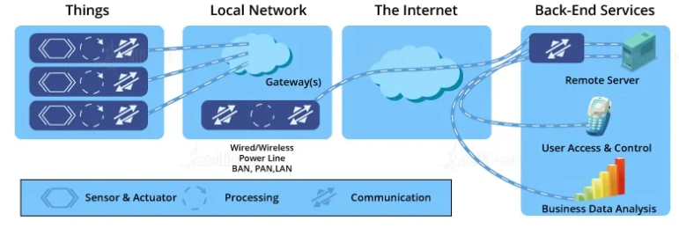
Contd…
An IoT system consists of four major components :

Slide 35
Contd…
IoT Devices: They are smart electronic gadgets that consist of wireless sensors that help in transferring data over the Internet.
Local Network: It helps in accessing the data from the devices connected to the Internet.
The Internet: It helps the devices connect with the user applications and servers.
Back-end Services: They consist of a remote server, user access and control, and mobile applications. These services constantly help in exchanging streamed data from various IoT devices and end-user applications.

Slide 36
IoT Characteristics
IoT provides various features that enables secure communication between heterogenous devices. Some features are as follows:
Connectivity : Connectivity is an essential requirement of the IoT infrastructure. The things of IoT are connected over Internet and can be accessed anytime from anywhere.
Scalability : IoT devices are designed in such a way that it is capable of handling expansion network.
- Sensing the sensors embedded in the things in IoT keeps regular monitoring for any changes in its state or physical environment such as changes in temperature, pressure, humidity etc.

Slide 37
Contd…
Heterogeneity : The things in IoT are able to handle huge data across different platform and networks.
Dynamic & Self Adapting : The IoT devices can dynamically adapt themselves to any changes in IoT system.
The components of IoT can change this state dynamically.
Intelligence : Each IoT device has a unique identity. They can convey information about themselves and can also obtain information from other things.
Security : The mechanism such as encryption, decryption of generated data are implemented for data safety.

Slide 38
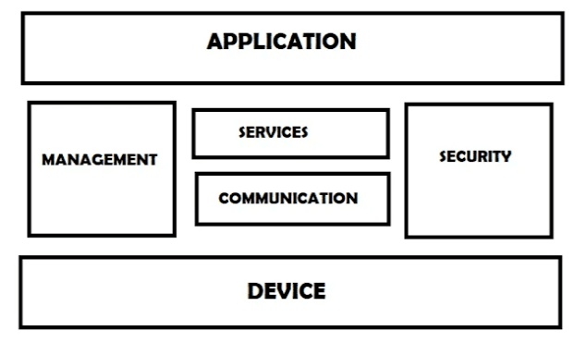
IoT Functional Blocks
An IoT system consists of a number of functional blocks like Devices, services, communication, security, and application that provide the capability for sensing, actuation, identification, communication, and management.

Slide 39
Contd…
It consist of devices that provide monitoring control functions, handle communication between host and server, manage the transfer of data, secure the system using authentication etc.
Application : It is an interface that provides a control system that used by users to view the status and analyze the system.
Management : This functional block provides various functions that are used to manage an IoT system.
Services : This functional block provides some services like monitoring and controlling a device and publishing and deleting the data and restoring the system.

Slide 40
Contd…
Communication
This block handles the communication between the client and the cloud-based server and sends/receives the data using protocols.
Security
This block is used to secure an IoT system using some functions like authorization, data security, authentication, 2-step verification, etc.
Device
These devices are used to provide sensing and monitoring control functions that collect data from the outer environment.

Slide 41
Physical Design of IoT
The physical design of an IoT system is referred to as the Things/Devices and protocols that are used to build an IoT system.
All these things/Devices are called Node Devices and every device has a unique identity that performs remote sensing, actuating and monitoring work.
And the protocols that are used to establish communication between the Node devices and servers over the Internet.

Slide 42
Things/ Devices
Things/Devices are used to build a connection, process data, provide interfaces, provide storage, and provide graphics interfaces in an IoT system.
All these generate data in a form that can be analyzed by an analytical system and program to perform operations and used to improve the system.

Slide 43
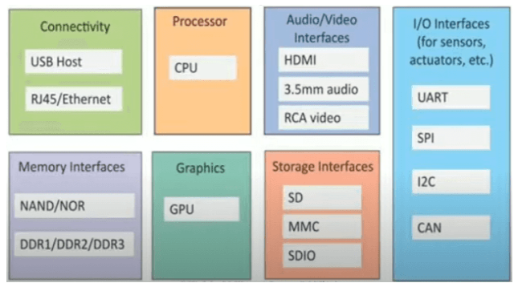
Generic Block Diagram of IoT

Slide 44
Contd…
Connectivity
Devices like USB hosts and ETHERNET are used for connectivity between the devices and the server.
Processor
A processor like a CPU and other units are used to process the data. these data are further used to improve the decision quality of an IoT system.
Audio/Video Interfaces
An interface like HDMI and RCA devices is used to record audio and videos in a system.
Input/Output interface
To give input and output signals to sensors, and actuators we use things like UART, SPI, CAN, etc

Slide 45
Contd…
Storage Interfaces
Things like SD, MMC, and SDIO are used to store the data generated from an IoT device.
Other things like DDR and GPU are used to control the activity of an IoT system.

Slide 46
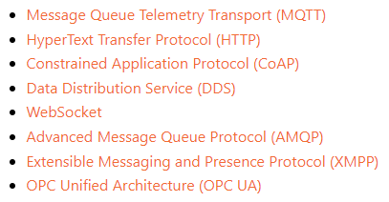
IoT Protocols

Slide 47
Message Queue Telemetry Transport (MQTT)
Designed to be lightweight, so it can work in very low bandwidth networks.
It allows communication between nodes in both reliable and unreliable networks.
MQTT follows a publish/subscribe architecture, meaning that there are nodes (brokers) that make the information available, while others (clients) can read the available information after subscribing by accessing the corresponding URL.
A use case of MQTT is in a smart factory where there are temperature sensors installed along with the production plant. The installed sensors will connect to the MQTT broker and will publish the data within sensor topics.
Afterwards, the MQTT clients, which can be of several types and quantities, will subscribe to the same topic in order to read the temperature data. An example of an MQTT architecture is shown.

Slide 48
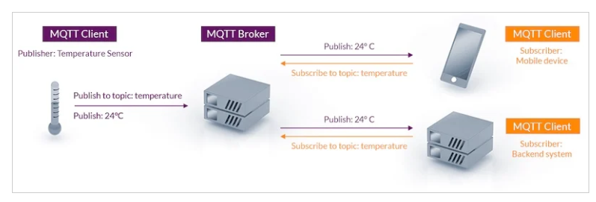
MQTT Example

Slide 49
HyperText Transfer Protocol (HTTP)
This protocol has been the origin of data communication for the World Wide Web (WWW), so logically it is being used in the IoT world. However, it is not optimized for it because of the following:
The HTTP is made for two systems communicating to each other at a time, so it is time and energy-consuming to connect several sensors to get information.
The HTTP is unidirectional, made for one system (client) to be sending one message to another one (server). This makes it quite hard to escalate an IoT solution.
Power consumption: HTTP relies on TCP, which requires a lot of computing resources, so it is not suitable for battery-powered applications.

Slide 50
Constrained Application Protocol (CoAP)
CoAP is a web transfer protocol to be used with limited networks with low bandwidth and low availability. It follows a client/server architecture and is built similarly to HTTP. Servers make resources available with an URL, and clients can make requests of types GET, POST, PUT and DELETE.
The CoAP communication links are 1:1 and UDP-based, so the delivery is not guaranteed. CoAP is made to work in highly congested networks, where nodes do not have a lot of intelligence and are not always working.

Slide 51
Data Distribution Service (DDS)
Similar to MQTT, DDS follows a publish-subscribe methodology, with the main difference being that there are no brokers. It means that all publishers (i.e., temperature sensors) and subscribers (i.e., mobile phones) are all connected to the same network. This network is known as Global Data Space (GDS) and it interconnects each node with all the other ones to avoid bottlenecks. An example of the DDS GDS is shown.

Slide 52
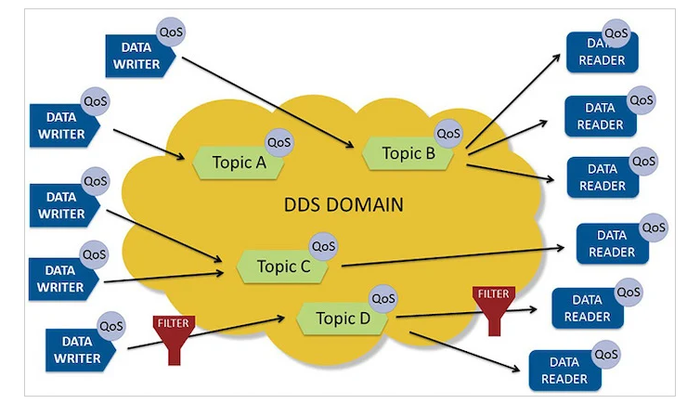

Slide 53
WebSocket
Linked to the HTTP protocol, the WebSocket technology establishes a TCP connection between a browser and a server, and then both of them exchange information until the connection is closed. Figure shows a high-level comparison between HTTP and WebSocket.

Slide 54
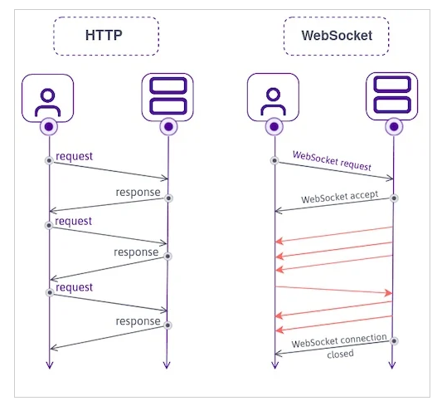

Slide 55
Advanced Message Queue Protocol (AMQP)
AMQP accepts publish/subscribe architectures, as well as request/response types. It is TCP-based, so delivery is guaranteed, as well as acknowledgment, which makes this protocol reliable, with the consequent overhead message reliability.
Compared to MQTT, AMQP offers two Quality of Service levels:
At most once: the sender does not wait until having an acknowledgment from the receiver to delete a message.
At least once: for each message, the sender will receive an acknowledgment from the receiver before deleting the message. In a case where the acknowledgment is lost, the message is re-sent.
Exactly once: the messages are sent only once. It requires special coordination between the sender and the receiver.

Slide 56
Extensible Messaging and Presence Protocol (XMPP)
It is based on Extensible Markup Language (XML) and in the past, it was known as Jabber. It is an open-source, decentralized, secure protocol to exchange XML messages.
A characteristic factor of XMPP is its addressing method and how nodes are identified. It uses a Jabber ID with the format jabberID@domain.com, which allows two nodes to interchange information regardless of the distance between them.

Slide 57
OPC Unified Architecture (OPC UA)
It is a standard made for industrial communication, strongly oriented to guarantee interoperability between manufacturers, operating systems, and programming languages.
All in all, the OPC UA is a transport-agnostic protocol, so it supports both of the previously used architectures: request/response (such as WebSocket or HTTP), as well as the publish/subscribe (such as the MQTT).

